Slide 1
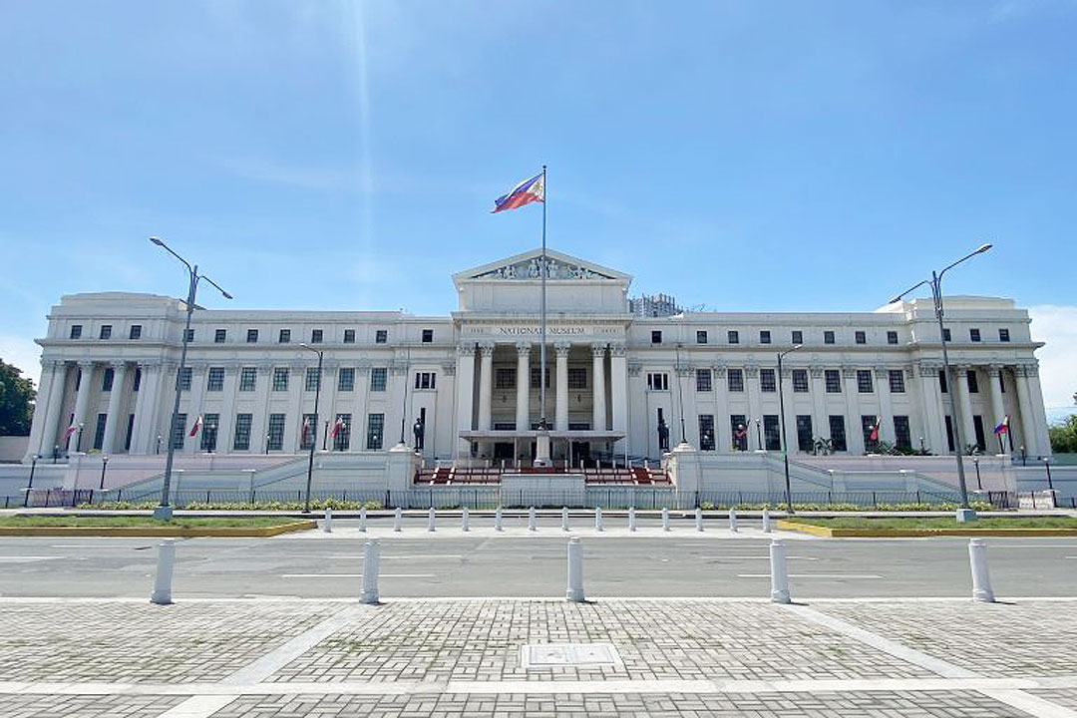
Museum and Gallery Etiquettes
ART APPRECIATION

Slide 2
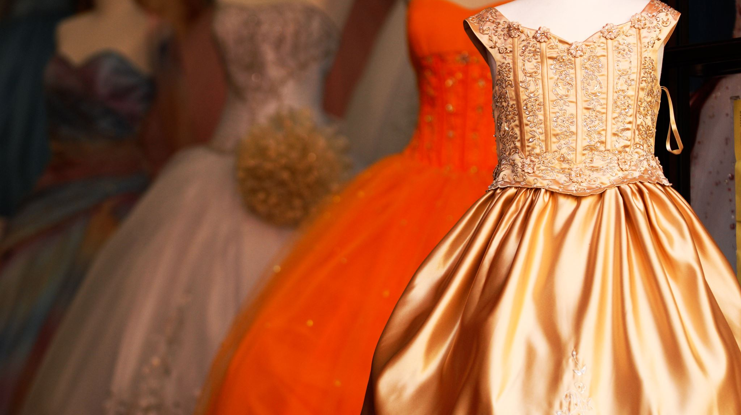
1. How you dress
It does not always have to be too flashy or formal. Some special events in galleries and museums like opening receptions may be more special than regular days, hence people would usually dress in formal attire. However, on a normal day museum or gallery visitors can just dress casually. Wear clothes which would show respect to such settings.

Slide 3

Quick Facts:
Some terms used when mounting artwork:
Wall bound-the artwork is installed mainly on a wall and is applicable mostly, but not limited, to two-dimensional works.
Free standing-has no support underneath because the artwork can stand on its own
On a pedestal - a neatly furnished rectangular-prism type of wood is used to raise small and medium-sized sculptures to hip-level point of view.

Slide 4
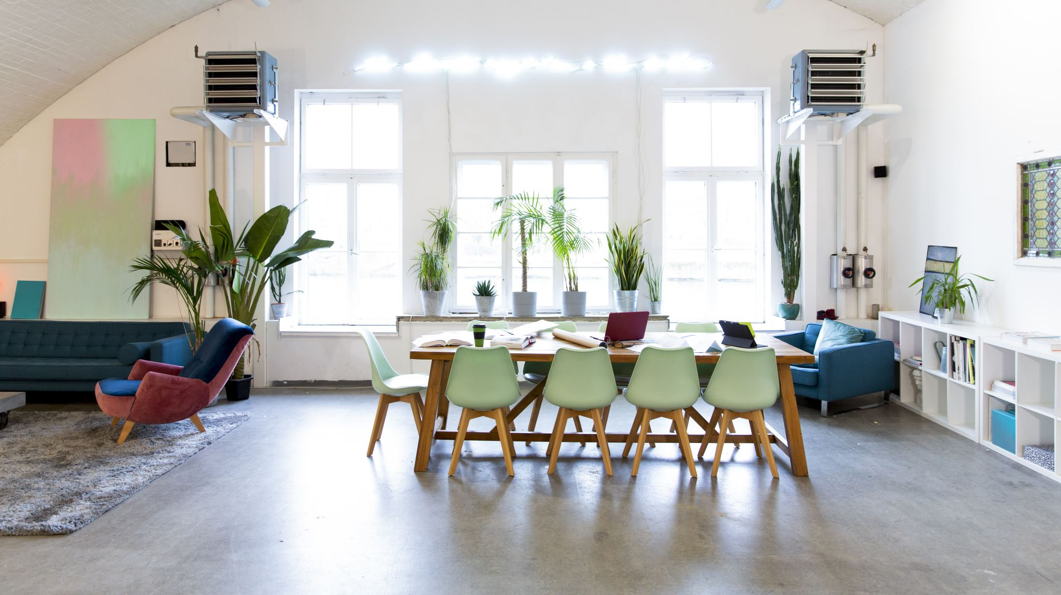
2. Where should you eat
Some museums have cafes-the only areas where you are allowed to eat. In galleries, eating is only appropriate during openings and cocktails are usually served. However, these are not supposed to be full meals; they are just light snacks, so eat lightly and in the spaces designated for eating.

Slide 5
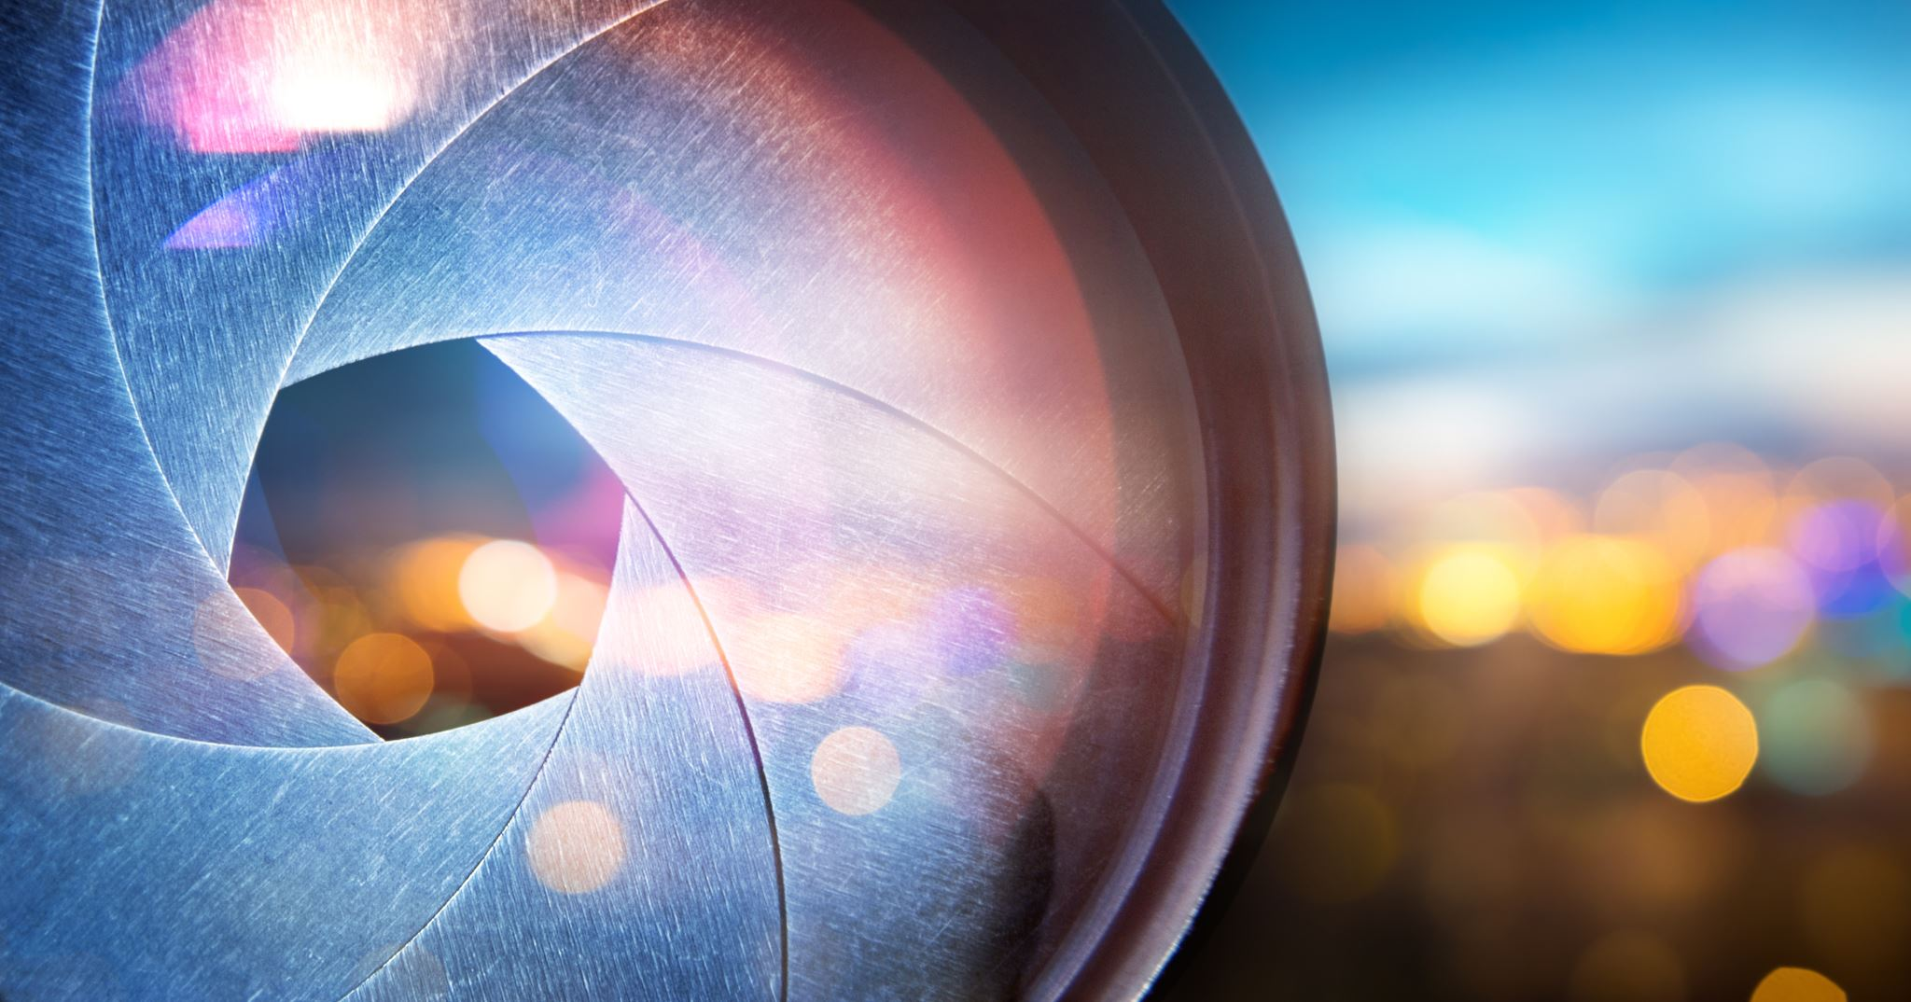
3. When taking photos
avoid using flash photography because the light could affect the vibrancy of a painting's color. Some paints are light-sensitive and they also naturally fade over time. Do not speed up the fading process by using the flash when clicking your camera.

Slide 6
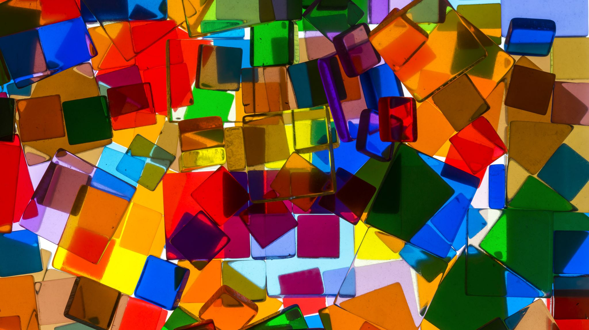
4. Selfies and funny poses
In museums, a lot of paintings and artifacts are deeply venerated for their depictions of some of the most important pains and victories of a country or region. Hence, our behavior should also be properly coordinated.

Slide 7

5. Talking and jesting
It is definitely okay to talk and discuss some artworks, but if your voice is louder than normal, then it could distract and disturb other gallery visitors.

Slide 8
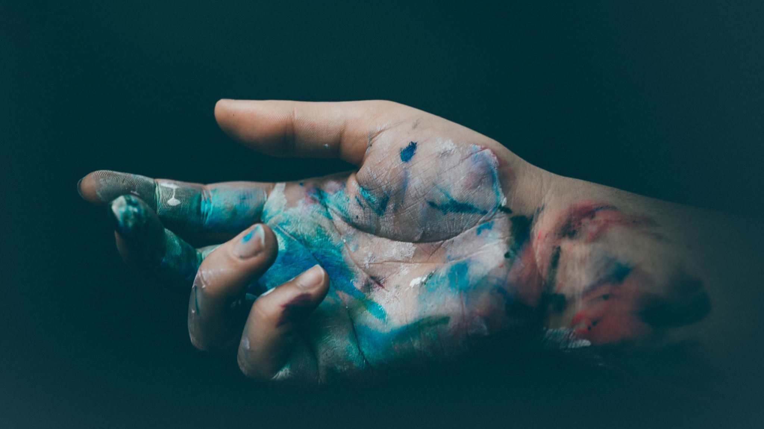
6. Touching
Some contemporary art these days are meant to be touched, but most works are NOT. Our fingers have sweat glands which can affect the chemical properties of a painting or sculpture's surface. Human sweat can be acidic and this can have deteriorating effects on a work of art.

Slide 9
Knowing the National Museum of the Philippines
We are blessed to have an established institution that houses some of the most important national and even world-renowned cultural heritage. These treasures are more than what money can buy because they are records of both history and human excellence. We will not always have a Luna living in our days, but his art is very much alive on the walls of our National Museum along with those of other Filipino artists.

Slide 10

Quick Facts:
What is the difference between a gallery and a museum?
Some people often interchange these two terms, especially if they are not immersed in a culture of going to art exhibitions. However, it is very easy to distinguish between a gallery and a museum.

Slide 11
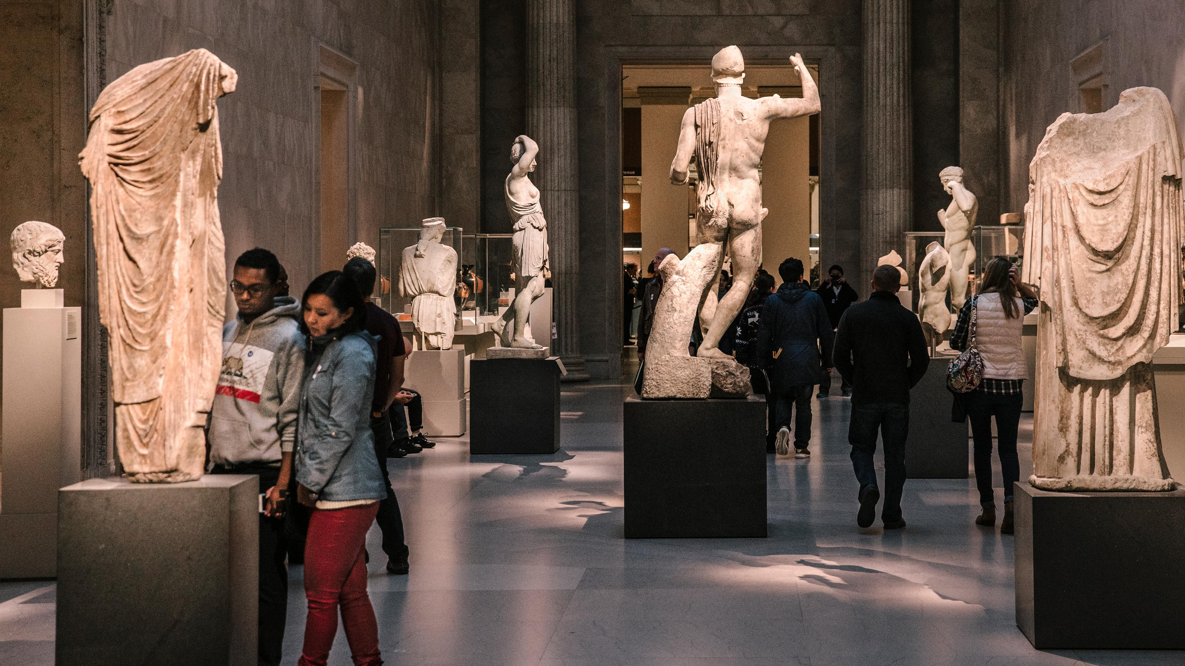
Museums
are institutions that display art which can also be considered as national treasures because of its importance to a place's history. Hence, a lot of artworks are actually very old and are on display for exhibition's sake. Yes, they can be bought and they have monetary value but very seldomly and only to a select clientele.

Slide 12
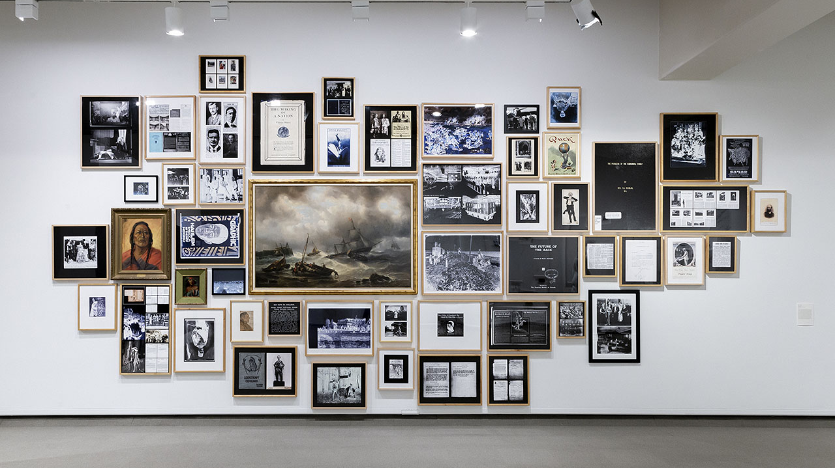
gallery
holds regular exhibitions and is more commercial in nature. They aim to sell artwork to collectors to earn a profit. Can galleries display non-sellable art? The answer is yes, but only occasionally since they are privately only owned, hence they base their capital on the sales during their shows.

Slide 13
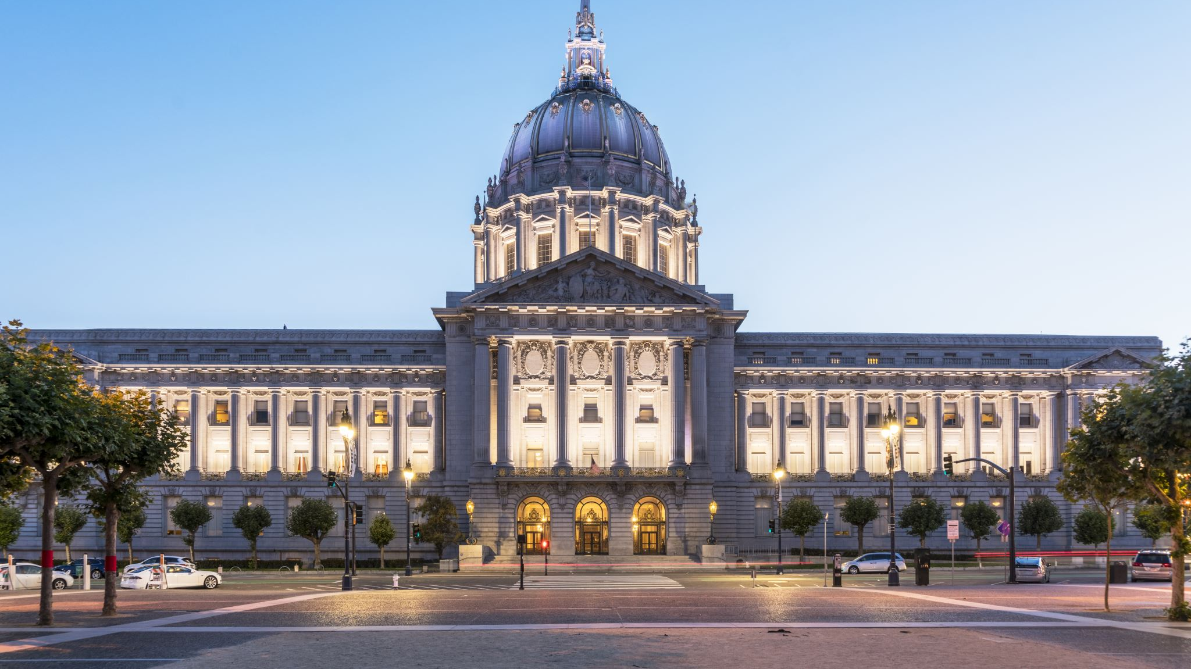
The National Museum is a public space and is meant to be visited by us, the Filipino people. It was mandated in the year 1998 to acquire, document, preserve, exhibit, and foster scholarly studies and public appreciation of works of art, specimens, and cultural and historical artifacts representative of our unique cultural heritage and natural history.

Slide 14
Here are some important aspects of the museum that you must know:
It has nineteen (19) regional branches throughout the archipelago comprising the national network. Check if your local museum is part of this.
The museum areas are in a complex: The National Art Gallery was formerly the Legislative building occupied by the Senate and House of Representative (lower ground then functioned as National Library); the National Museum of Anthropology (old finance building), and the newly-renovated National Museum of Natural History (formerly the department of Tourism building).

Slide 15
Nation Museum of Fine Arts
National Museum of Anthropology
National Museum of Natural History (The architectural design of the buildings is neoclassical style)

Slide 16
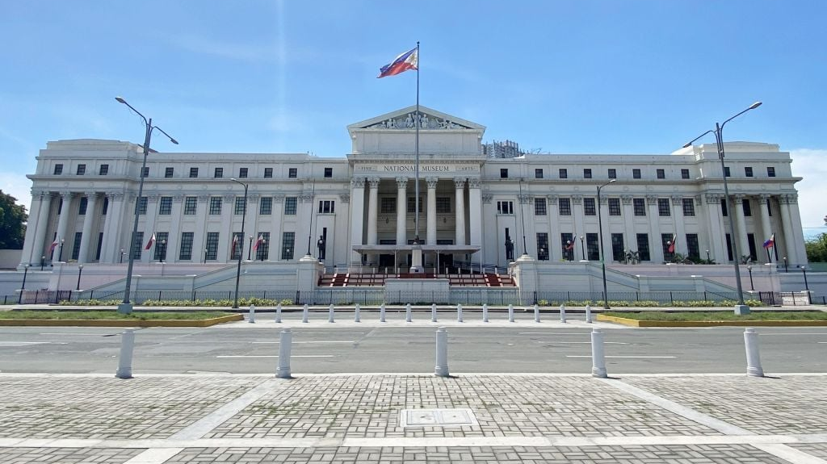

Slide 17
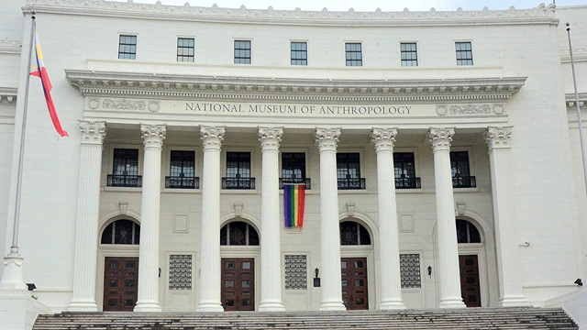

Slide 18
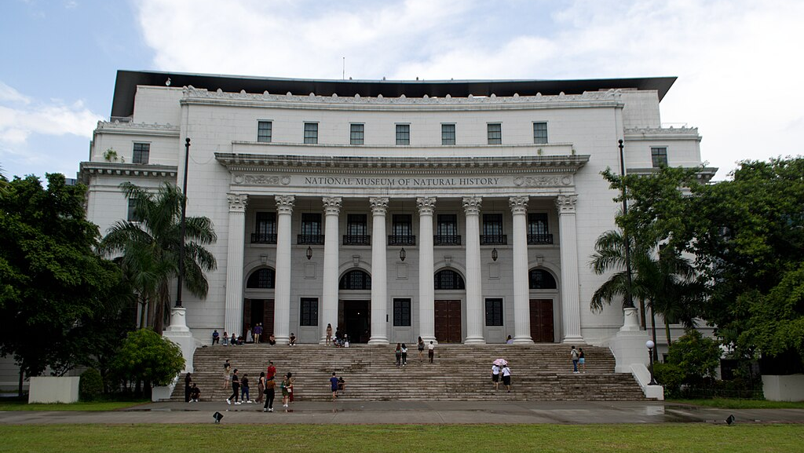

Slide 19
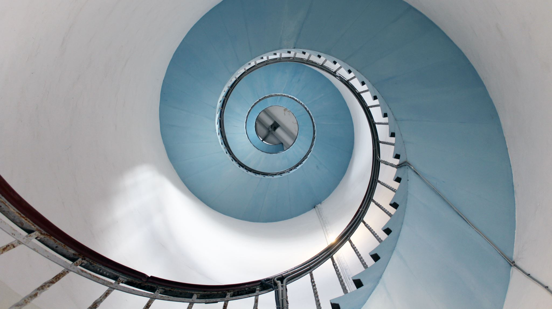
The stairway boasts of the neoclassical style of the Museum (came to reality by virtue of the National Museum Act of 1998
This DNA-type helix structure is right at the center of the Museum of Natural History. Inside is a scenic elevator that takes you through the entire height and breathtaking view of the building.

